Slide 1
IEEE Day is 1 October 2024
Are you ready?
IEEE Day In a Box
~ contains everything you need to know to hold a successful celebration
ieeeday.org
Notes:
The IEEE Day team, comprised of IEEE volunteers from all 10 IEEE Regions as well as IEEE staff, are working on empowering members to plan dynamic events that honor the very first IEEE Day. Collaboration will make this IEEE Day bigger and better than ever before. In 2024, we are celebrating the 15th anniversary of IEEE Day and the 140th anniversary of IEEE.

Slide 2
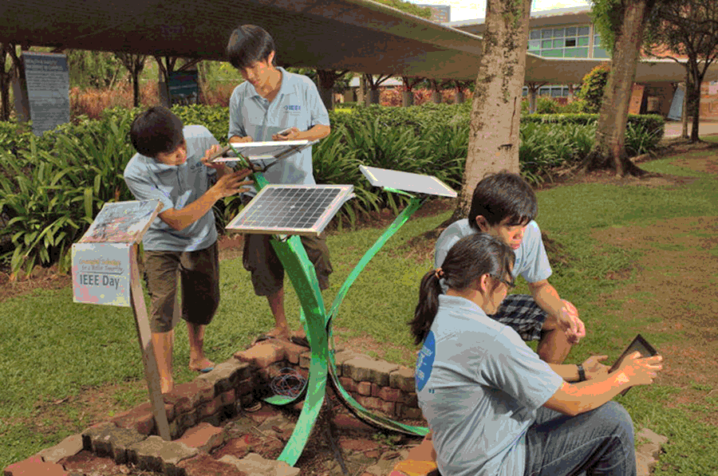
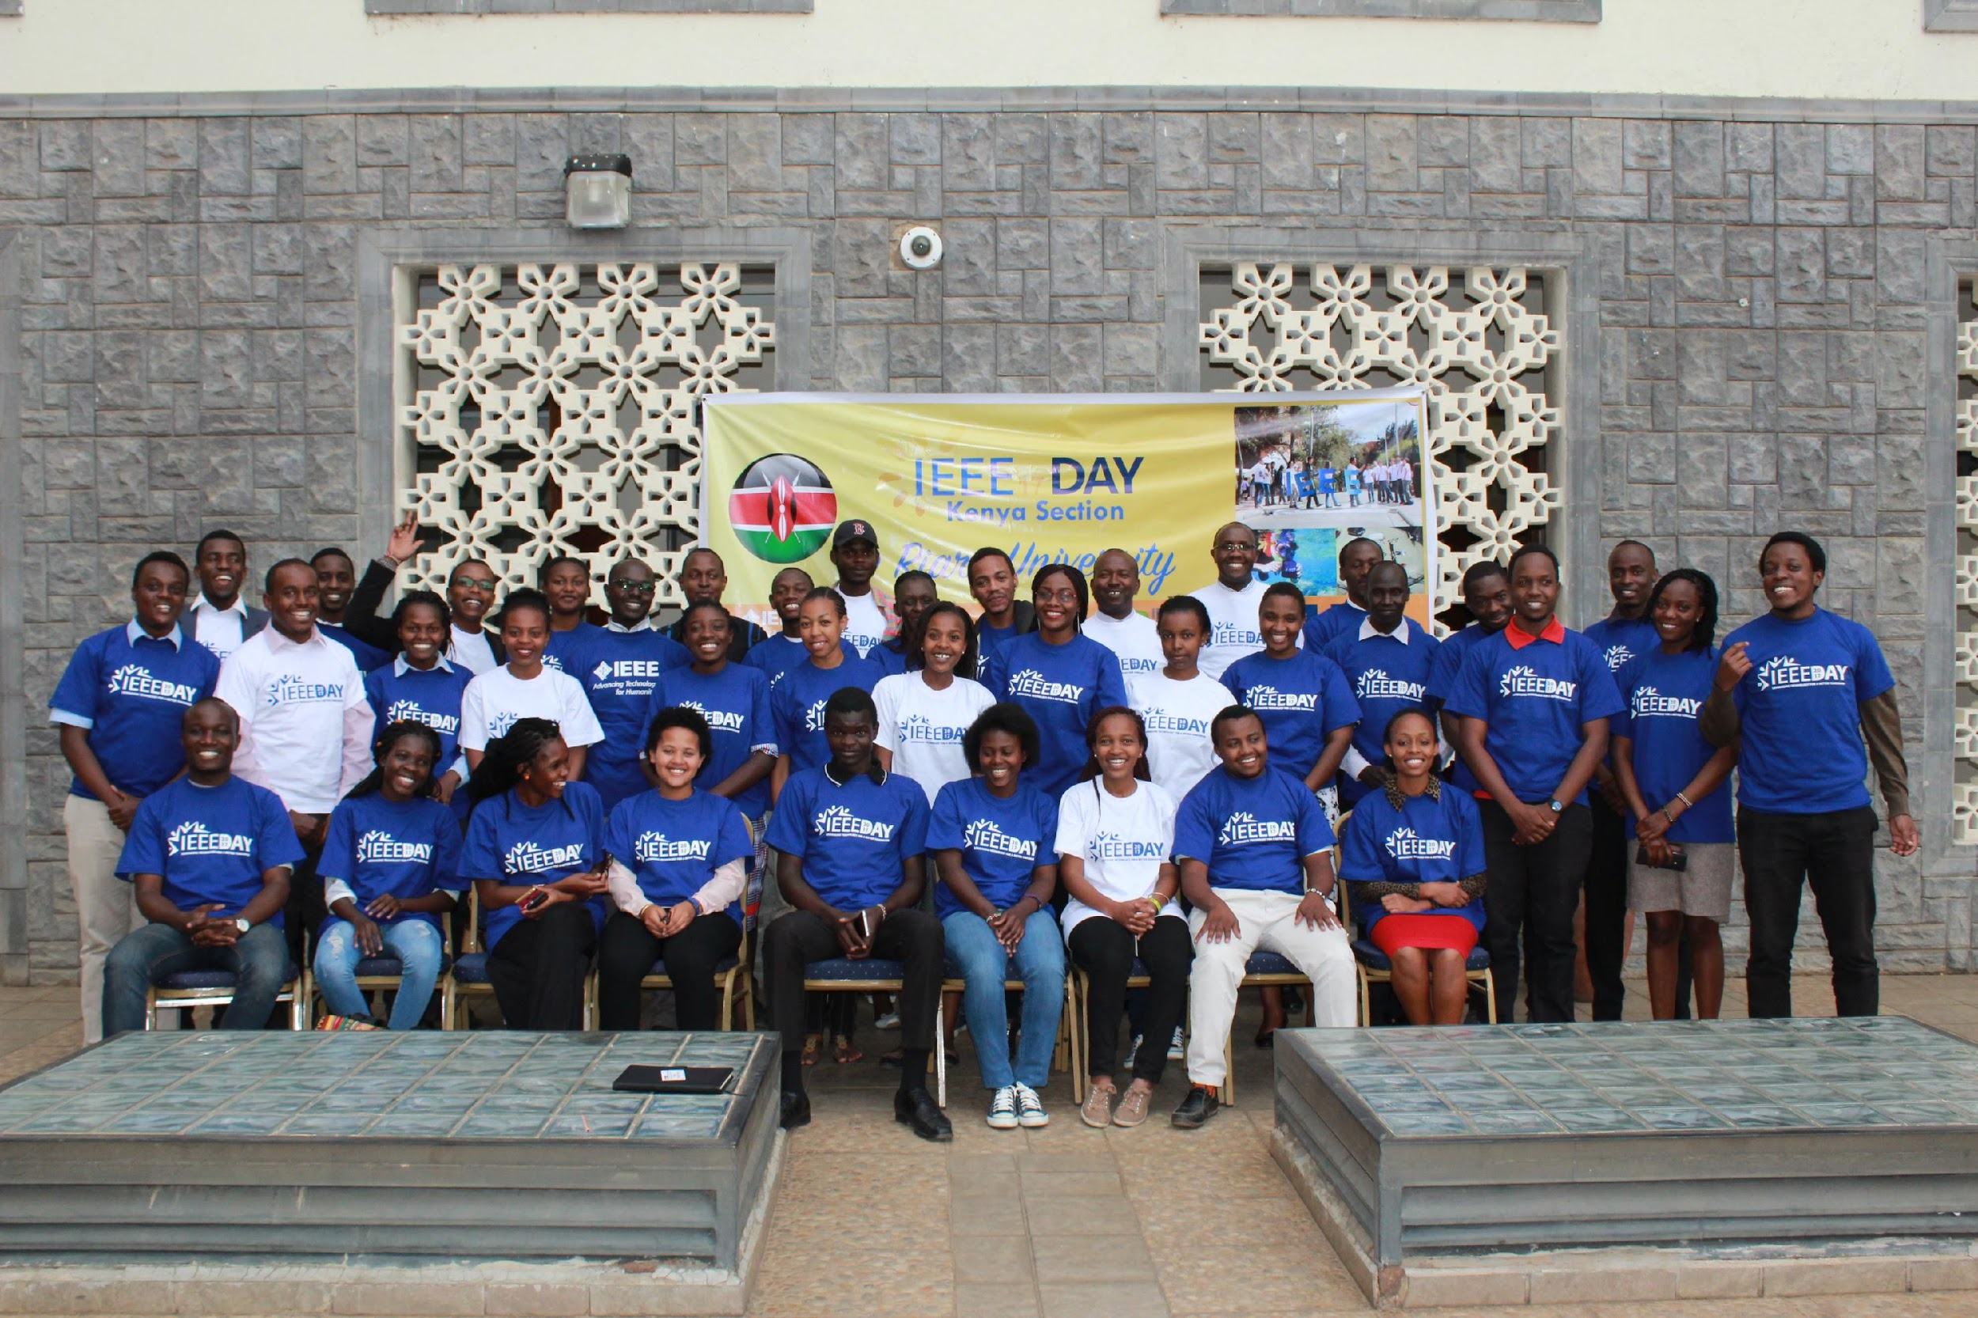
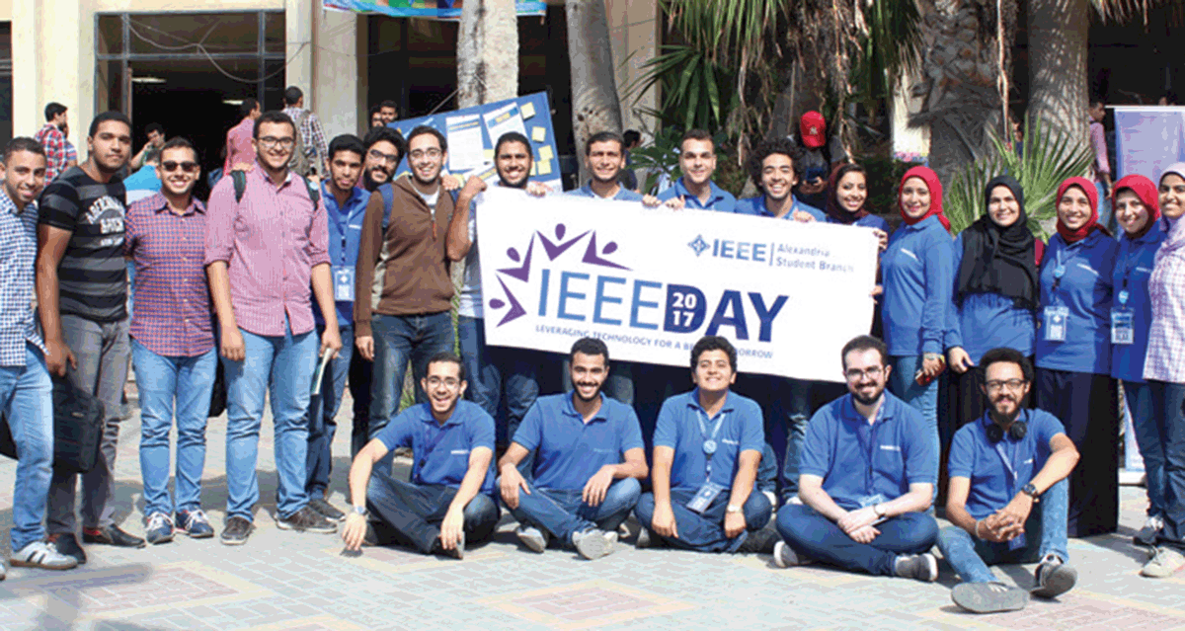
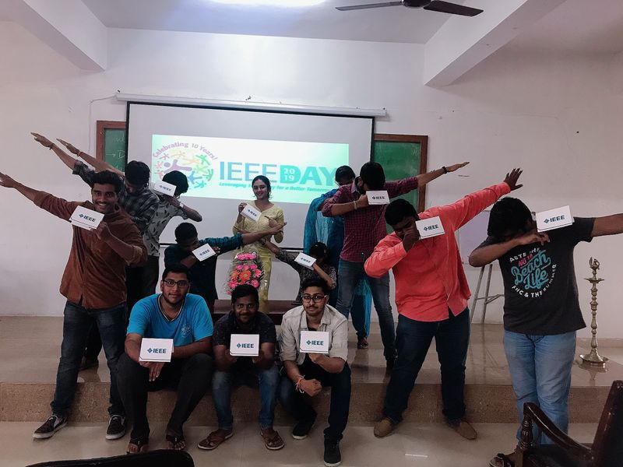
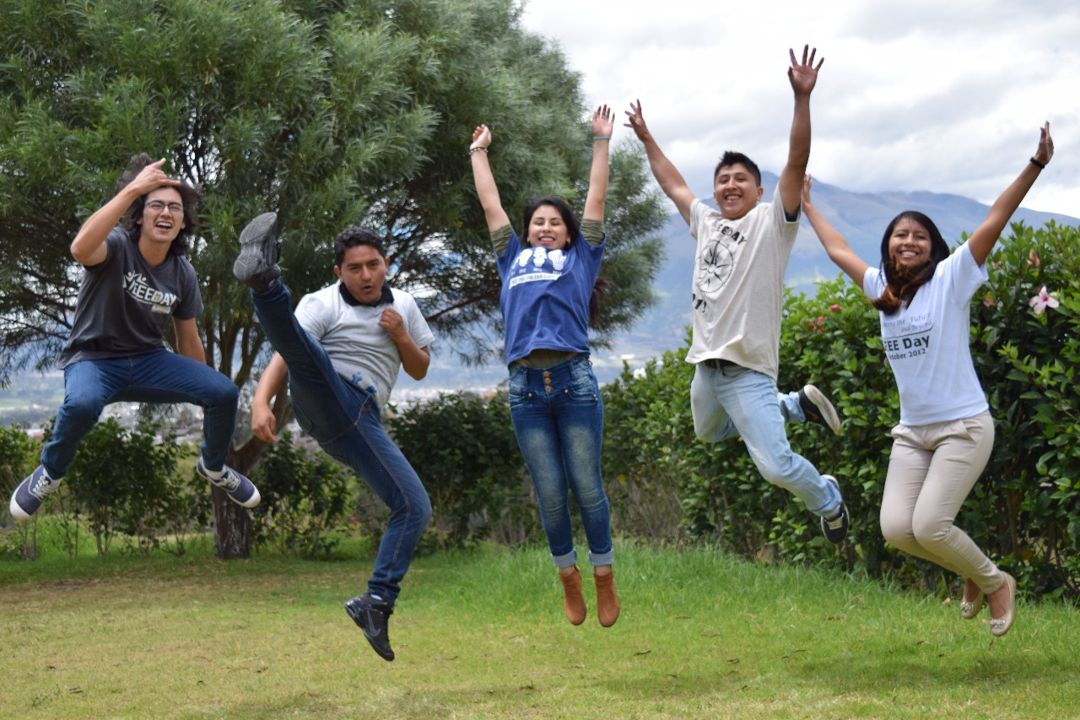
IEEE Day in History
Did you know?
IEEE Day commemorates the anniversary of the first time when IEEE members gathered to share their technical ideas, which took place in 1884.
It is celebrated on the first Tuesday in October.
The first IEEE Day took place in 2009 with 80 events around the world and has grown exponentially during the past 15 years.
Let’s keep the momentum going this year!
Notes:
Worldwide celebrations demonstrate the ways thousands of IEEE members in local communities join together to collaborate on ideas that leverage technology for a better tomorrow. We celebrate IEEE members! We know, with your help, we can keep the momentum going by holding both in person and virtual events this year.

Slide 3
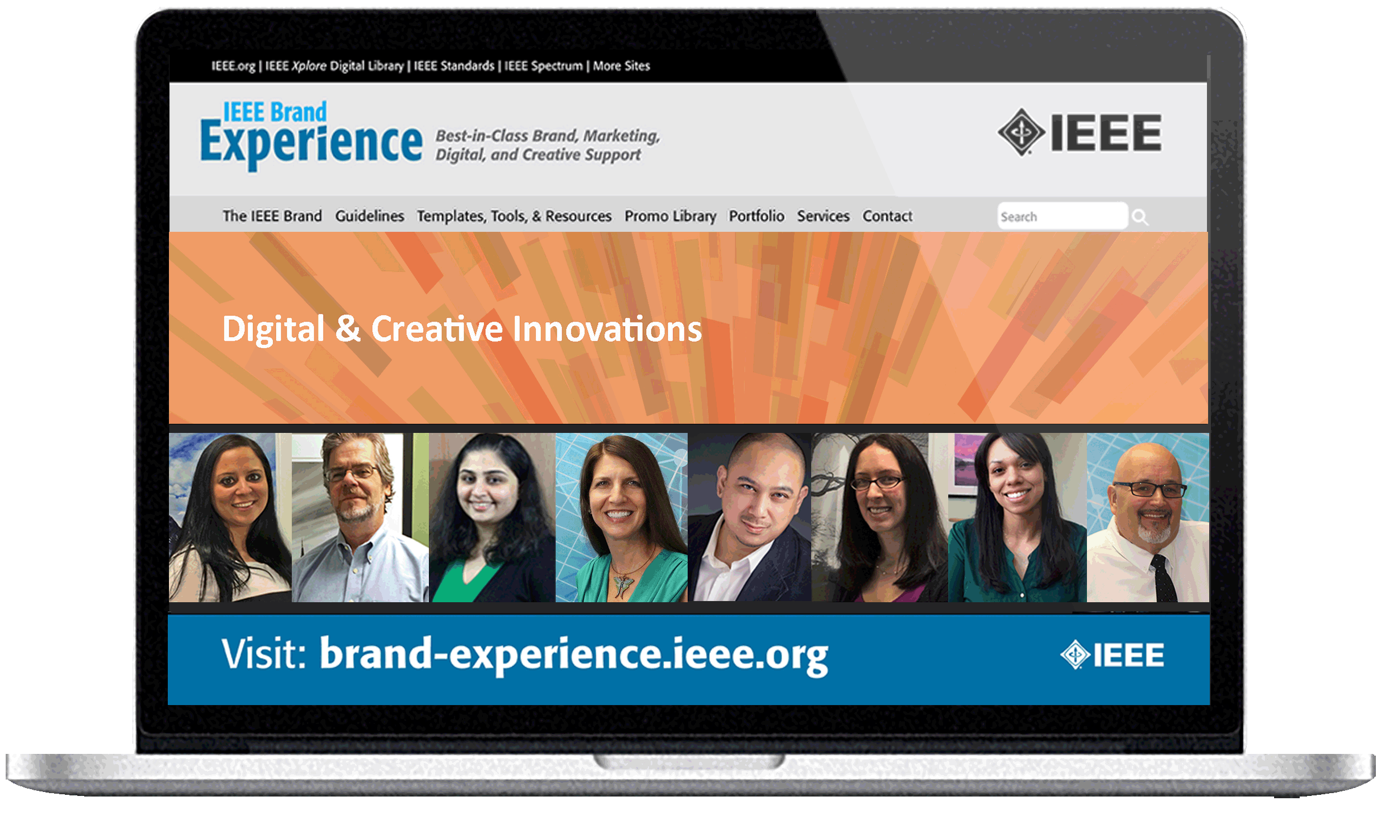
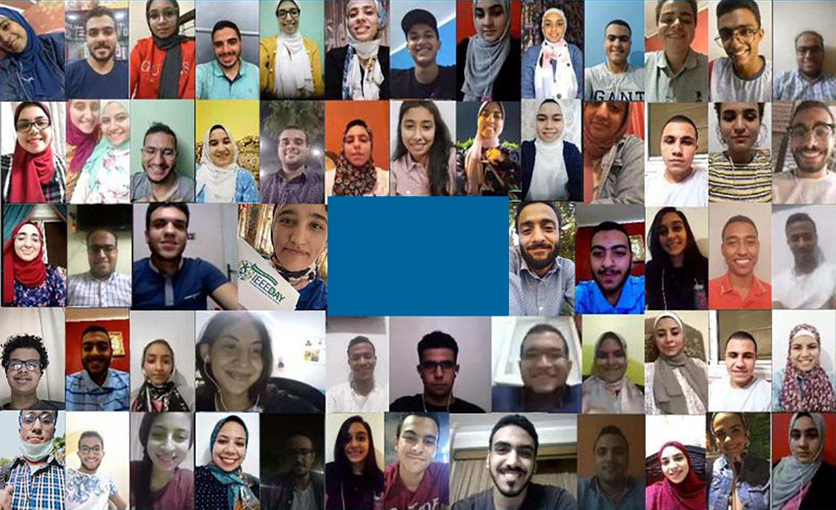
What’s in this toolkit?
ieeeday.org
All of the tools and resources you need in order to:
come up with an idea to celebrate
build a solid plan, and…
execute!
Notes:
Our job is to support you and your local Section in planning your event for IEEE Day. In this kit, you will find a wealth of resources to successfully plan an event. It includes everything from coming up with an event idea, to promoting and executing your event, participating in contests, and continuing the conversation with your local members and prospective members.

Slide 4
10 Steps to Success…
IDEATE
ORGANIZE
PARTNER
PROMOTE
FOLLOW THROUGH
1
2
3
4
5
PARTICIPATE IN CONTEST
VOTE
STAY CONNECTED
SUBMIT
EVENT
CELEBRATE
6
7
8
9
10
Notes:
Luckily, there’s 10 easy steps to success! Each of these steps will walk you through what’s needed to make your event successful, from the inception of your idea all the way through the event’s impact. Let’s walk through the 10 steps.

Slide 5
Step 1...IDEATE
Great events start with great ideas!
IDEATE
1
EXAMPLES INCLUDE:
Virtual meetups and networking Connect with potential partners with similar interests via the IEEE App.
Discounts and promotional codes Virtual tech-exhibits at museums, tech-themed movies, STEM activities
Online team coding events
Assembling a technical activity or coding as a team
Virtual technical topics and discussion
Latest Tech Topics such as: Autonomous, wearables, tech-ethics, privacy, blockchain, IoT, AI
Virtual mission-based/Humanitarian and Philanthropic Opportunities
Education and partnership
If you currently participate in activities that involve working with children,
or plan to do so, please review the following important documents.
The Guidelines are referenced within the IEEE Civility Policy.
These procedures apply to events that are specifically designed for children.
Link to the guidelines:
www.ieee.org/about/volunteers/risk-insurance/ieee-activities-with-children.html
Notes:
Step 1: Come up with a good idea!
Are you struggling with an idea for your event? Don’t stress, we have created a number of event suggestions that have broad interest and appeal, and they range from very small to very large. No event is too small - wherever members are celebrating together, whether in person OR virtually, it’s IEEE Day!
Visit ieeeday.ieee.org/events-idea to peruse event ideas and get inspiration.

Slide 6
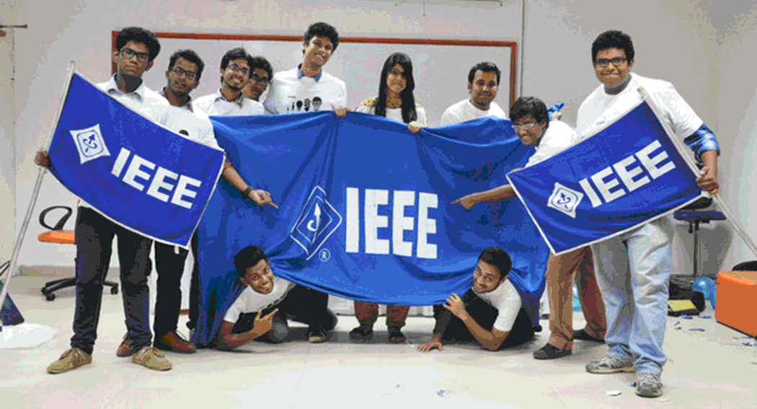
Step 2…ORGANIZE
Build a Proper Foundation
ORGANIZE
2
Plan for the needs of your event
Set the date and time
Set a realistic budget
Identify an appropriate format for the activity
Print your IEEE Day materials so they are ready for your event
Find templates in the IEEE Day Toolkit: ieeeday.org/toolkit
Notes:
For Step 2, you’ll need to map out all of the needs of your event. The best place to start is nailing down the date. Will you plan your event on IEEE Day, or is it best to celebrate during the week of 1 October? (where you can take advantage of all the offerings and new member Join discount)
Next, determine your budget - that will inform many other aspects of the event, including the venue, food, program, registration, travel, equipment, and entertainment options.
Depending on your budget, you may want to seek partnership with venues that may offer you space for free - including your local library, office space or conference rooms in your organization, university lecture halls or classrooms, museums, park or outdoor locations, off-hours at local place of business, or local restaurant. If working with a limited budget, you can be creative with one of these options. (members place of business - conference rooms)
You will also want to think about the flow of the event. How much time will there be for formal presentation? Will there be food served, and how much will be needed? How will you handle dietary restrictions? What equipment will be needed and will you be able to purchase or rent?
And how will you help non-members understand how they can become a member through the event?

Slide 7
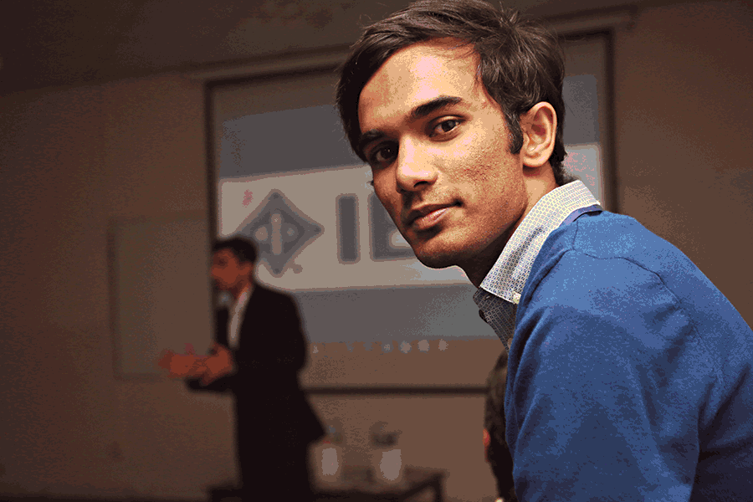
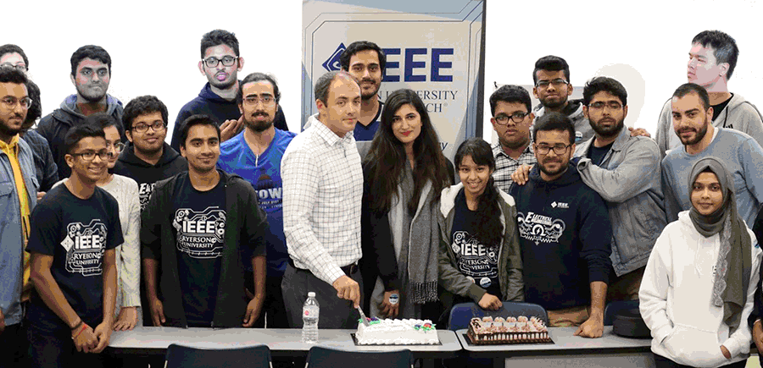
Step 3…PARTNER
This could involve:
PARTNER
3
Reaching out to your Region Lead
Assembling your team for larger efforts
Working with local IEEE groups or local organization for event space and tasks
Engaging a guest speaker, enlist sponsors for virtual events
Notes:
For Step 3, it’s time to partner with the appropriate resources to begin organizing your event. If you are new to planning an event, you may want to reach out to your Region Lead, Ambassadors, or past event organizers for guidance. Depending on the size of your event, these resources may be able to guide you in creating an organizing team with defined roles for marketing, technical program oversight, budgeting, and event logistics. Sharing in the responsibility with your respective team members and determining clear roles and accountability will give you a better chance for success.
Your event may also warrant partnering with a guest speaker or a host for the event, and your Region Lead can guide you here.

Slide 8
Step 4…Promote
Expand through available channels
PROMOTE
4
Get the word out in:
Your newsletter
Social media—IEEE groups and local groups
Engineering school communication vehicles
eNotice invite
Company communications
And make sure to let attendees know about all that IEEE offers year-round!
Note - Be sure your communications are compliant: http://sites.ieee.org/gdpr
Notes:
Now that you’ve got a great event idea, started organizing your event, and partnered with a powerful team, you’ll need to get the word out about your plans in Step 4! There are many ways to promote your event and capture interest, and you’ll need to try several avenues to attract different people. Consider promotion through your local IEEE newsletters, communication vehicles at your university or organization, and social media. Think creatively about how to best reach your target audience, and focus your efforts there.
Be sure to comply with data privacy restrictions. Learn more at sites.ieee.org/gdpr/
And be sure to have a clear call to action to register so that you have an accurate headcount. Include a registration link, whether through a Facebook event or other event registration vehicle. If you use vTools, these events will show in IEEE Collabratec and give you more visibility and the opportunity to remind a larger community about your event. (registration link and information can be included in your event notice) (We might want to say something to the effect that events in vtools will show in Collabratec, we can then post something in Collabratec that reminds members to check out the events for dates, time and description))
You’ll also want to include marketing materials for non-members. You want your peers to become members so that they can enjoy the full benefits of being an IEEE member. Utilize the materials from your Membership Development kit, and use the coupon flyer in the IEEE Day Toolkit to promote the new join discount.

Slide 9
Step 5...FOLLOW-THROUGH
The work is not done once you send out initial promotions!
FOLLOW THROUGH
5
Continue to remind attendees and promote to those who may not yet have heard of your event
Notes:
Continue to remind registered attendees and members in your local Section about the event. If possible, create a calendar reminder or event notice so that you can avoid bombarding attendees with too much email. Be sure to remind participants close to the event.

Slide 10
Step 6...SUBMIT YOUR EVENT
Build a Proper Foundation
SUBMIT
EVENT
6
Let others know
about your event
Make sure you let IEEE know how successful your IEEE Day was!
Submit your event in IEEE vTools: vtools.ieee.org (identify with #ieeeday in special fields)
Notes:
At Step 6, be sure to let us know about the plans for your event via the Event Submission Form [NEED TO SET UP LINK ASAP]. Please let us know as much detail as you can provide - we want to know all about your event since we can’t be there in person! Just remember, events must be entered no later than the second week of October.

Slide 11
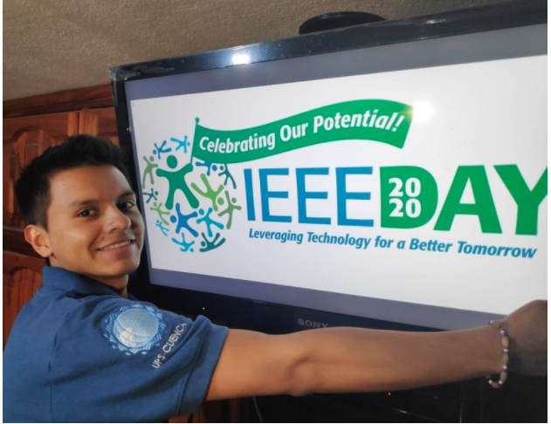
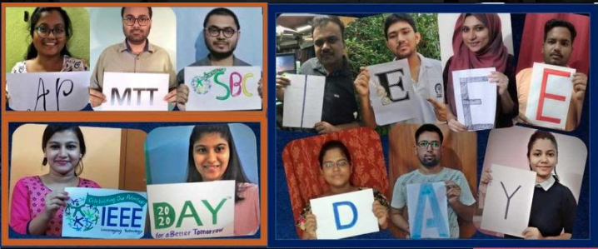
Step 7...CELEBRATE!
1 October 2024
CELEBRATE
7
Share live-stream to IEEE Facebook page!
Check out webinars on the IEEE Day Facebook page and throughout the week
Livestream #IEEEDay
Link to IEEE Day on Facebook:
www.facebook.com/IEEEDay
Notes:
Step 7 is the best step - it’s time to celebrate! You’ve done a lot of hard work to prepare for your event, and now it’s time to enjoy the company of your fellow members and prospective members. Take lots of photos and videos to capture the event and have lots of fun. Be sure to live stream the event on the IEEE Day Facebook page so that members around the world can share in the celebration.

Slide 12
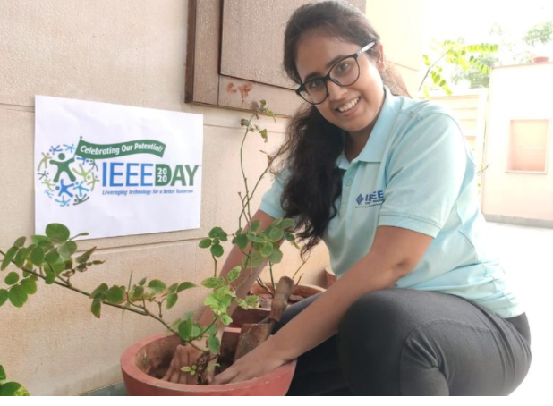
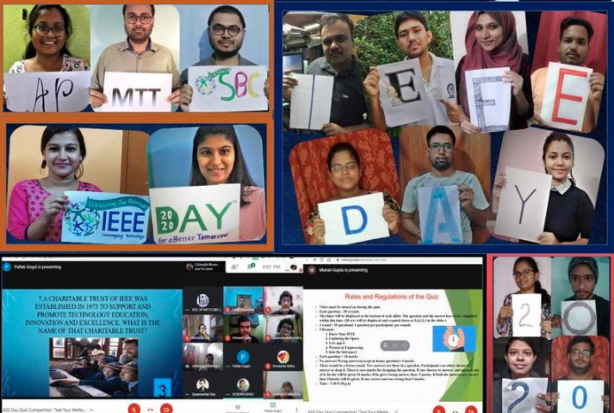
Step 8...PARTICIPATE Time for Photo & Video Contests!
Winners Announced:
PARTICIPATE IN CONTEST
8
Submit the photos and videos of your event to win exciting prizes!
Notes:
Next, enter your favorite photos and videos in the IEEE Day Photo and Video contests. Winners will receive cash prizes...anything else to add here about the contests? Maybe add the winners will be posted on the IEEE website, the IEEE Day FB page and in IEEE Day Collabratec community. Winners will be announced in the IEEE Day Collabratec community

Slide 13
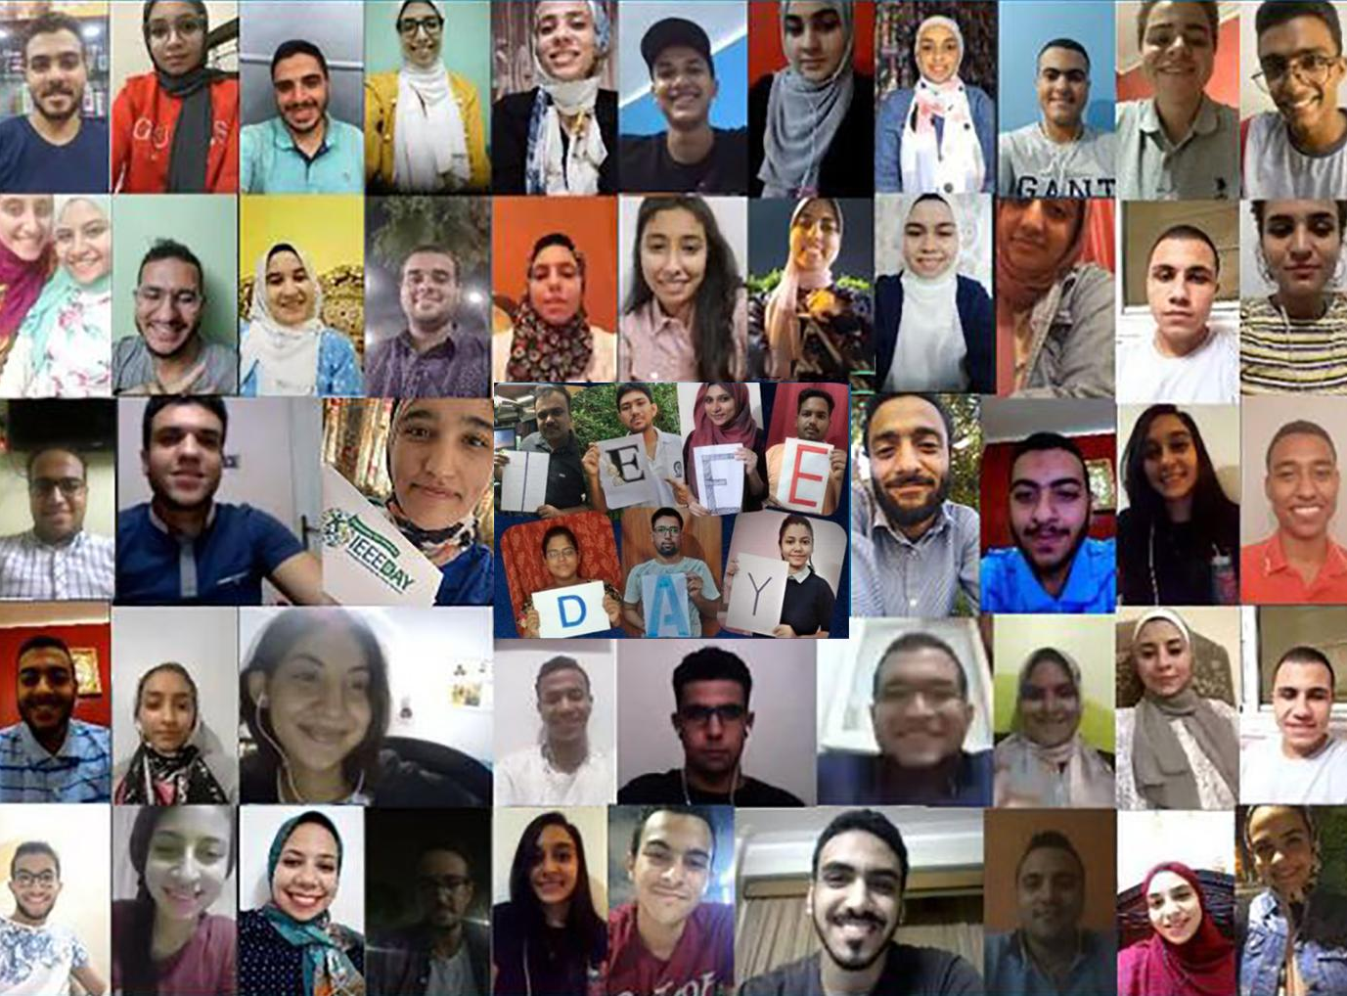
Step 9...VOTE
Make your voice heard!
VOTE
9
Show support to your fellow IEEE members and vote on the photo and video contest
Notes:
And don’t forget to vote on your favorite photos and videos and support your fellow members as well. This is also a great way to learn about other events across the world, and maybe even spark an idea for future events.

Slide 14
Step 10…STAY CONNECTED
STAY CONNECTED
It’s not over when it’s over!
Be sure to recognize those who contributed to the success of IEEE Day!
Share analytics with your Region Lead, and give an update in Region and Section newsletters
Continue outreach with attendees and your members to remind them of local events all year long via email, social media, and future events.
10
Notes:
After IEEE Day, the meaningful connections you made through your event should grow throughout the year! If you worked with an event team, it’s important to recognize them through your Sections social media, newsletters and other communications channels.

Slide 15
Social Media
#ieeeday
ieee-collabratec.ieee.org/app/community/48/IEEE-Day/
facebook.com/IEEEDay/
instagram.com/ieeeday/
twitter.com/IEEEDay
linkedin.com/groups/3240378
ieeetv.ieee.org/channels/ieee-day
ieeeday.org

Slide 16
For more information: ieeeday.org/contact-us/
IDEATE—ORGANIZE—PARTNER—PROMOTE—FOLLOW THROUGH—SUBMIT EVENT—CELEBRATE—PARTICIPATE—VOTE—STAY CONNECTED
Thank you!
We hope you have a great IEEE Day!!

